Slide 1
NDA Roadmap
Cloud Volumes Services for AWS
Cloud Volumes Services for GCP
Azure NetApp Files
March 2019

Slide 2
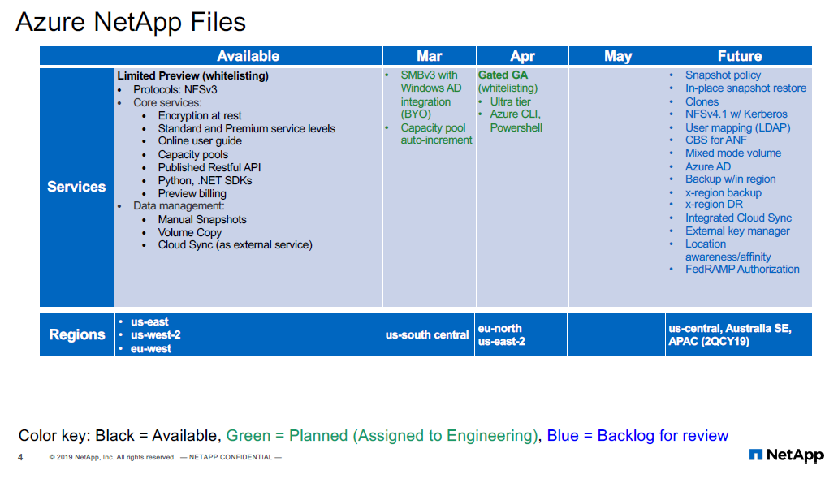

Slide 3
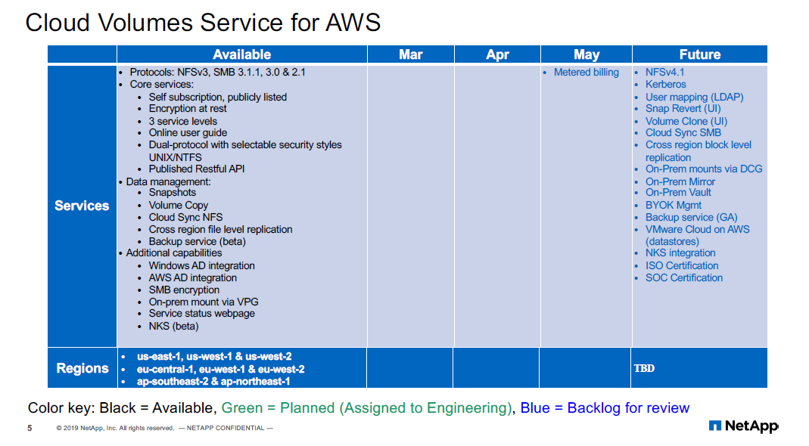

Slide 4
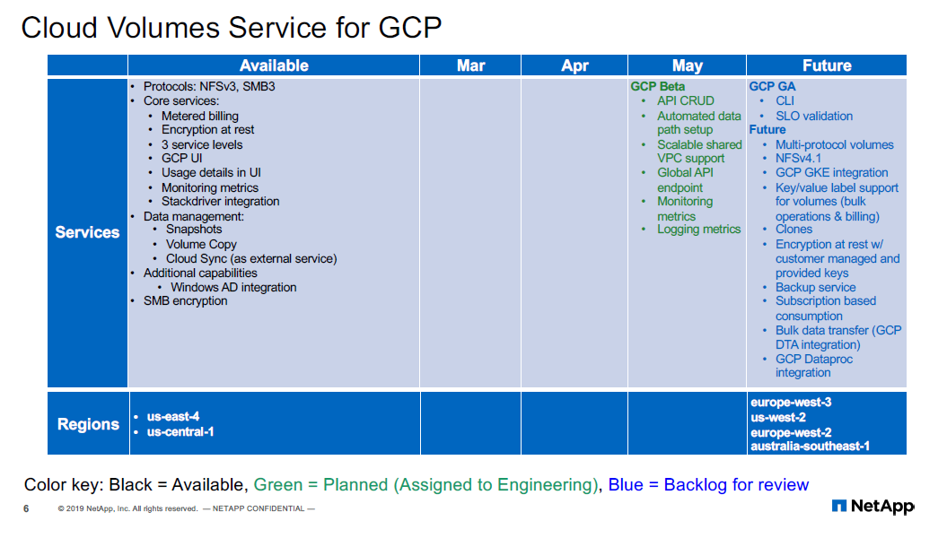

Slide 5
Thank You

